Slide 1


Employee Performance Analysis: A Comprehensive Approach
In today's competitive business landscape, understanding and enhancing employee performance is critical for organizations to achieve their strategic goals. This presentation outlines a comprehensive approach to employee performance analysis using Microsoft Excel, a powerful tool that allows for efficient data collection, analysis, and visualization. We aim to provide a clear understanding of the process, from problem statement to results, empowering you to make data-driven decisions that optimize your workforce.
by Giri prasad D.S

Slide 2

Problem Statement: Unlocking the Potential of Your Workforce
Many organizations struggle to effectively assess and improve employee performance. Existing systems may be outdated, lacking the sophistication needed to capture nuanced performance indicators. This can lead to inaccurate assessments, limited insights, and missed opportunities for growth. To overcome these challenges, we propose a data-driven approach utilizing Excel to provide a comprehensive and actionable analysis of employee performance.
Inefficient Performance Measurement
Lack of Data-Driven Insights
Without robust data analysis, it's difficult to identify trends, patterns, and areas for improvement, hindering effective decision-making regarding talent development and resource allocation.
Traditional performance metrics may not capture the full picture of employee contributions and potential, leading to incomplete and potentially inaccurate assessments.
Limited Growth Opportunities
Without a clear understanding of individual strengths and areas for development, organizations may miss opportunities to nurture talent and unlock the full potential of their workforce.

Slide 3
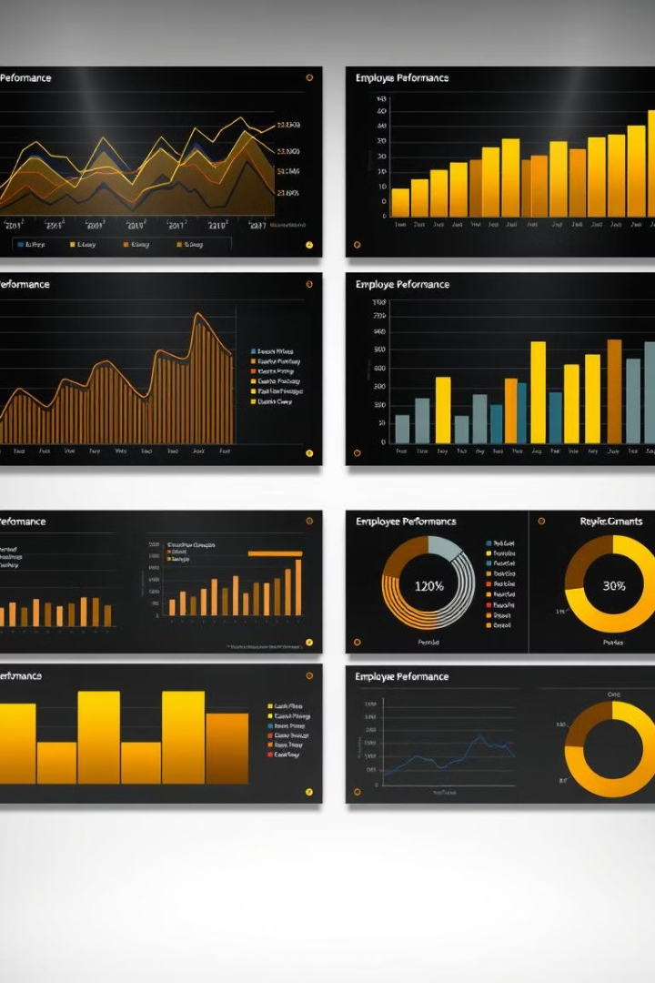
Project Overview: A Data-Driven Approach to Performance Enhancement
Our project aims to develop a robust employee performance analysis framework using Microsoft Excel. This framework will involve collecting relevant data points, utilizing various Excel functions for analysis, and creating insightful visualizations to identify key trends, patterns, and areas for improvement. The project will focus on identifying and addressing specific performance challenges, facilitating informed decision-making, and ultimately, enhancing overall employee performance and organizational success.
1
Data Collection and Preparation
This stage involves identifying relevant performance indicators, gathering data from various sources, and cleaning and preparing the data for analysis. Excel's data manipulation features will be leveraged to ensure data accuracy and consistency.
2
Data Analysis and Visualization
This stage utilizes various Excel functions and tools for data analysis, including descriptive statistics, correlation analysis, and regression analysis. Visualizations such as charts, graphs, and dashboards will be created to present insights in an easily understandable and impactful way.
3
Interpretation and Action Planning
This stage involves interpreting the results of the analysis, identifying key areas for improvement, and developing action plans to address performance challenges. The findings will be presented to stakeholders, facilitating informed decision-making and strategic interventions.

Slide 4
End Users: Empowering Decision-Makers and Employees
The end users of this project include various stakeholders within the organization, each with specific needs and objectives. This project will empower decision-makers, such as managers and HR professionals, to gain a deeper understanding of employee performance, enabling them to make informed decisions regarding talent development, resource allocation, and performance management strategies. Additionally, employees will benefit from the transparency and actionable insights provided by the analysis, enabling them to understand their strengths and areas for improvement, fostering personal growth and development.
Managers
HR Professionals
Employees
Managers will gain insights into team performance, identify individual strengths and weaknesses, and develop targeted strategies for improving team productivity and efficiency.
HR professionals will have access to data that supports informed decision-making regarding talent acquisition, training and development programs, and compensation and benefits packages.
Employees will benefit from personalized feedback and development plans, based on their individual performance data, fostering a culture of continuous learning and improvement.

Slide 5
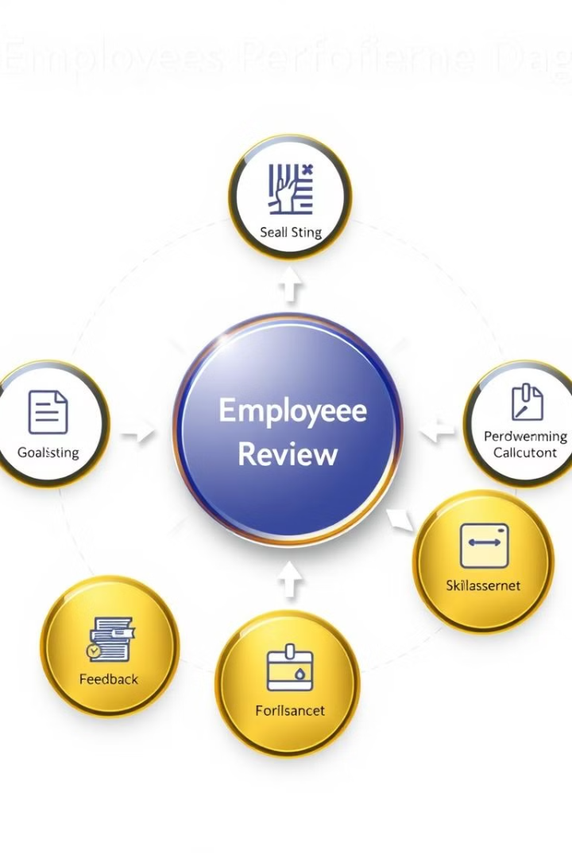
Our Solution and Proposition: A Powerful and Customizable Framework
Our solution provides a customizable and scalable framework for employee performance analysis using Microsoft Excel. This framework can be tailored to meet the specific needs of your organization, taking into account your unique performance indicators, organizational structure, and goals. Our approach focuses on data-driven decision-making, providing actionable insights to enhance employee performance and drive organizational success. This includes developing a robust data collection system, implementing a range of Excel analytical techniques, and presenting findings through clear and insightful visualizations.
1
Data Collection
2
Data Analysis
We will work with you to identify the key performance indicators that align with your organizational goals and design a comprehensive data collection system to capture this information effectively.
We will utilize a range of Excel functions and tools to analyze the collected data, including descriptive statistics, correlation analysis, and regression analysis. This will enable us to identify trends, patterns, and key areas for improvement.
3
Data Visualization
4
Action Planning
We will create clear and engaging visualizations, such as charts, graphs, and dashboards, to communicate the findings of the analysis in an easily understandable and impactful way.
Based on the analysis, we will work with you to develop action plans that address identified performance challenges, fostering a culture of continuous improvement and growth within your organization.

Slide 6
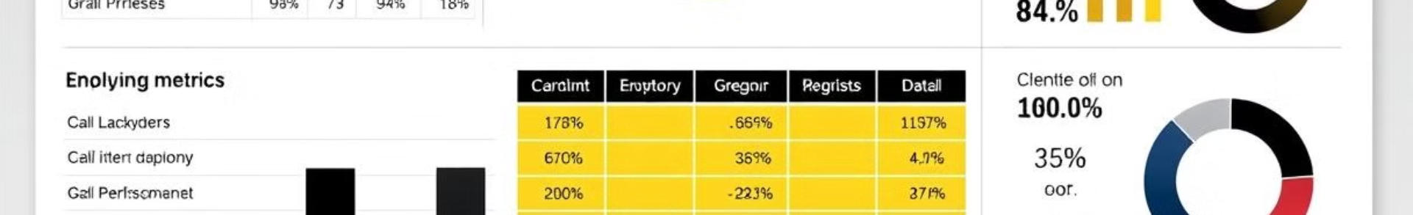
Dataset Description: Comprehensive and Nuanced Performance Indicators
The success of any employee performance analysis heavily relies on the quality and comprehensiveness of the data collected. This requires carefully considering the key performance indicators (KPIs) that are most relevant to your organization's goals and objectives. The dataset should include a mix of quantitative and qualitative data, providing a nuanced and holistic view of employee performance.
Quantitative Data
Qualitative Data
Productivity metrics (e.g., sales figures, output volume)
Performance reviews and feedback
Attendance and punctuality
Employee surveys and engagement scores
Training completion rates
Customer satisfaction ratings
Project completion timelines
Managerial observations and assessments

Slide 7





Modelling Approach: Unleashing the Power of Excel
Microsoft Excel provides a versatile and powerful platform for analyzing employee performance data. This section delves into the key modelling approaches and techniques that can be utilized to extract meaningful insights from your dataset. By leveraging various Excel functions, we can gain a deeper understanding of employee performance, identify areas for improvement, and ultimately, drive positive organizational change.
Descriptive Statistics
Basic descriptive statistics, such as averages, medians, and standard deviations, can provide a fundamental understanding of employee performance across various metrics.
Correlation Analysis
Correlation analysis helps identify relationships between different performance indicators, revealing potential dependencies and areas for further investigation.
Regression Analysis
Regression analysis can predict future performance based on historical data, enabling proactive planning and resource allocation.
Data Visualization
Excel's charting and graphing capabilities provide a powerful tool for presenting insights in a clear and visually compelling way.

Slide 8
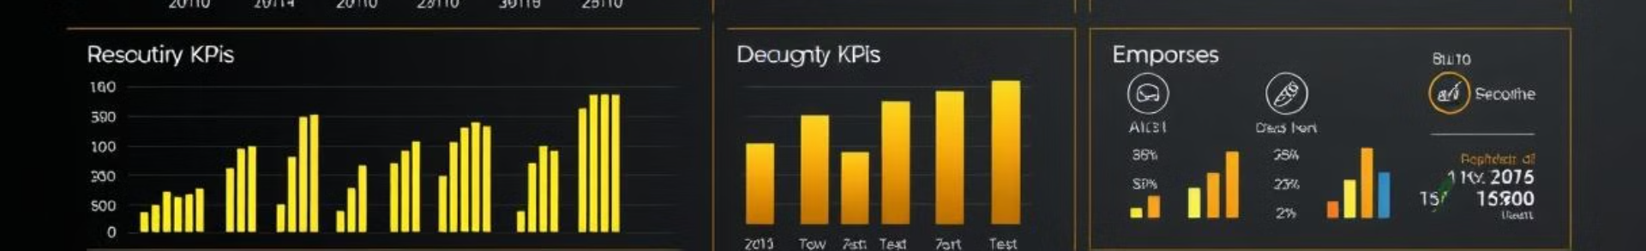




Results: Identifying Key Trends and Opportunities
The results of the employee performance analysis will provide valuable insights into the overall health of your workforce. This analysis will identify key trends, patterns, and areas for improvement, enabling you to make data-driven decisions that enhance employee performance and drive organizational success. The insights gleaned from the analysis will be presented in a clear and concise manner, utilizing charts, graphs, and dashboards to highlight key findings and recommendations.
Increased Productivity
Enhanced Employee Engagement
Improved Goal Alignment
Identified Talent Gaps
The analysis may reveal opportunities to improve workflows, streamline processes, or provide additional training to boost employee productivity.
The analysis may highlight gaps in goal alignment between individual employees and organizational objectives, enabling adjustments to ensure everyone is working towards shared goals.
The analysis may reveal areas where the organization needs to focus on talent development, recruiting, or training to address skill gaps and ensure future success.
The analysis may identify areas where employees feel undervalued or underutilized, leading to targeted interventions to boost engagement and morale.

Slide 9

Conclusion: Empowering Your Organization for Success
By implementing a robust employee performance analysis framework using Microsoft Excel, you can gain a comprehensive understanding of your workforce, identify areas for improvement, and empower your organization for success. This data-driven approach will enable you to make informed decisions regarding talent development, resource allocation, and performance management strategies, ultimately fostering a culture of continuous improvement and growth within your organization. This analysis is a powerful tool for unlocking the full potential of your workforce and driving sustainable organizational success.

